Slide 1

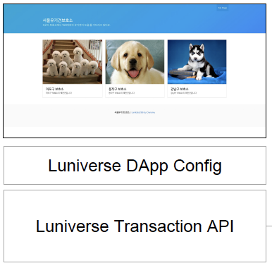
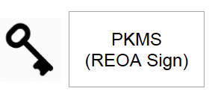
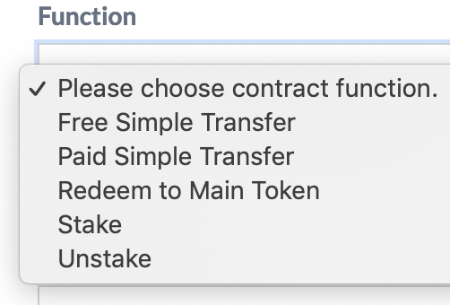
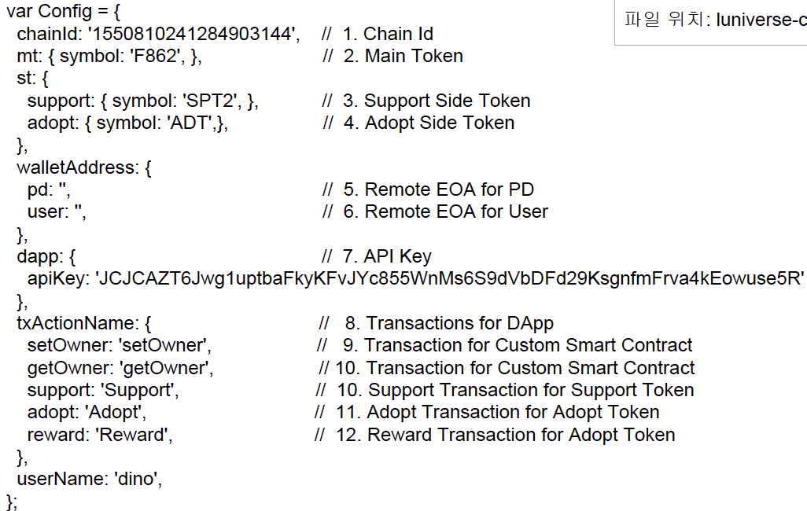
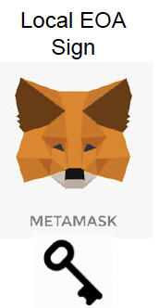
Wallet Bridge
Tx Nounce?
GAS ?
Side Chains
Account Bridge
Main Bridge
Contract
Signer Bridge
DApp
Side Bridge
Contract
Mainchain
(Ethereum)
Side
Chain
Main
Token
Side
Token
MT : ST = 1 : 10
제휴사
Luniverse
Side
Token
Side
Token
Transaction
Server
API Key
Config.js

Slide 2
Wallet Bridge
Tx Nounce?
GAS ?
Side Chains
Account Bridge
Main Bridge
Contract
Signer Bridge
DApp
Side Bridge
Contract
Mainchain
(Ethereum)
Side
Chain
Main
Token
Side
Token
MT : ST = 1 : 10
제휴사
Luniverse
Side
Token
Side
Token
Transaction
Server
API Key
Config.js

